Slide 1
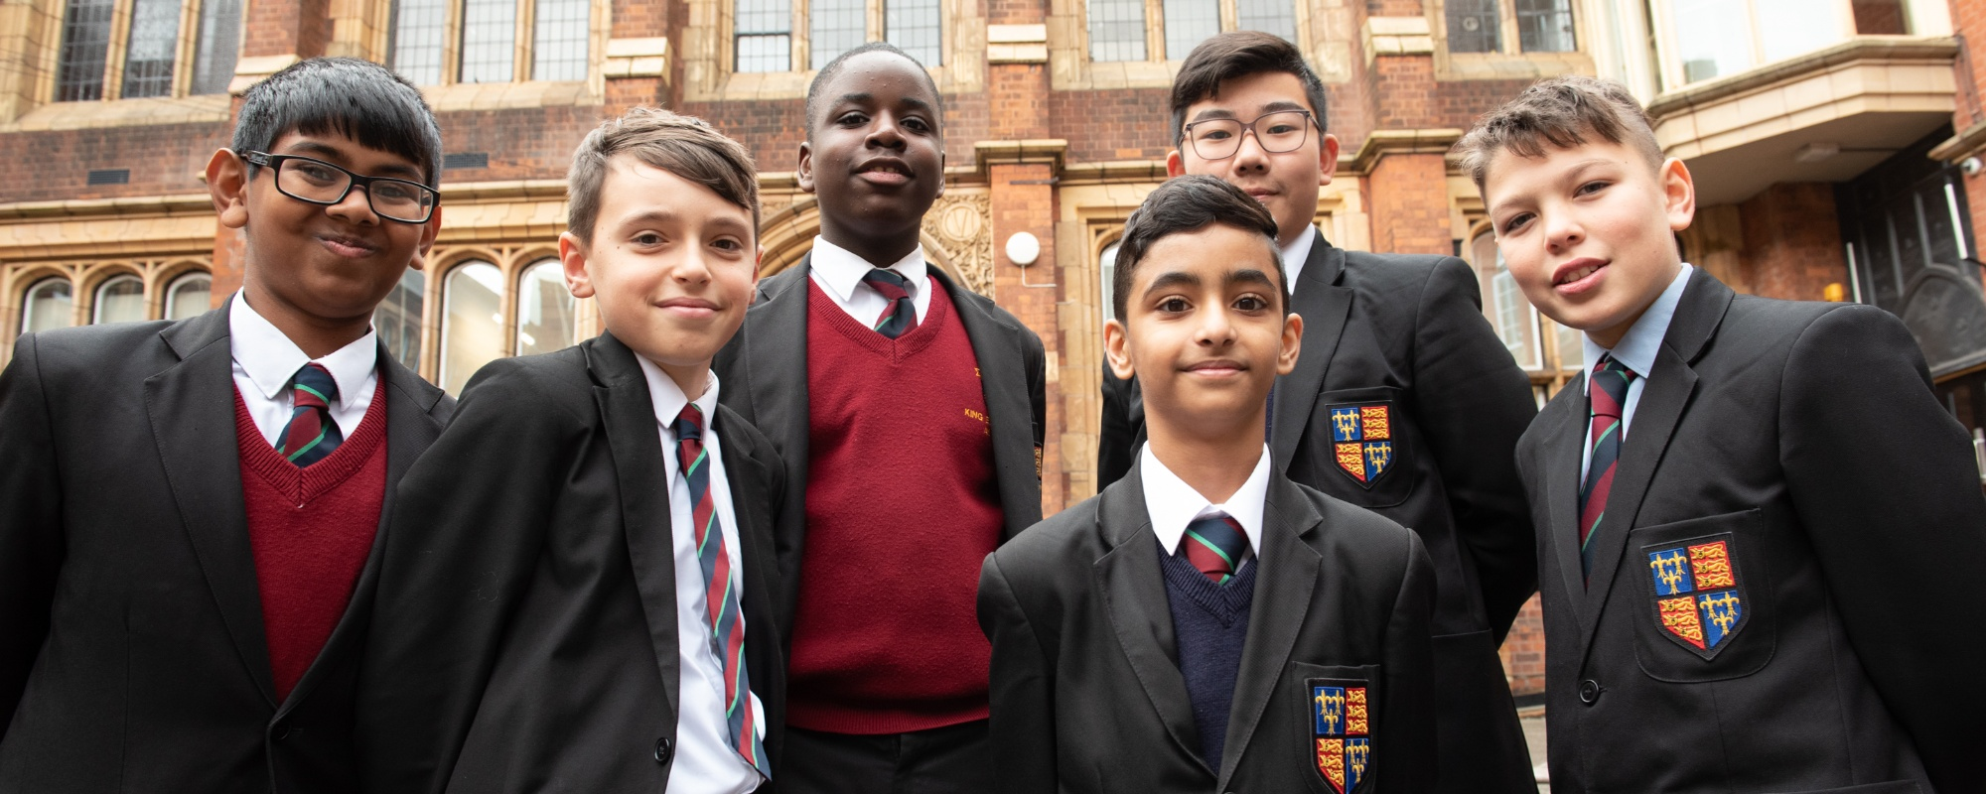
Open Morning Tuesday 10 March 2020
Welcome

Slide 2
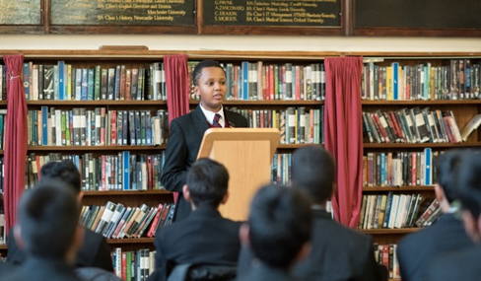
Some key dates
Deadline for appeals for September 2020 entry-27th March 2020.
Registration to sit the admission test for September 2021 entry opens on 4th May 2020 and closes on 26th June 2020.
Future open mornings on 7th July 2020 (9.15am-11.00am) and 24th September 2020 (5.00pm-8.00pm)

Slide 3
Admissions Policy from September 2020 entry
Common qualifying score was 205 for September 2020 entry.
Common priority score was 222 for September 2020 entry.
Common qualifying & priority scores for September 2021 entry will be set just before the admission test is taken (12th September 2020) for September 2021 admission.
Minimum of 25% of the total intake across the schools are made available for Pupil Premium applicants.
Each King Edward VI grammar school has a catchment area.

Slide 4
Over-subscription criteria
Looked after children who achieve the qualifying score.
Children attracting the pupil premium funding (free school meals) who live in the catchment area and achieve the qualifying score. No limit on the number of places.
If the above does not result in 25% of the admission intake the remaining places up to 25% will be offered to children attracting pupil premium funding who live outside of the catchment area who achieve the qualifying score.
Applicants who achieve the priority score and live in the school’s catchment area. Applicants with a sibling at the school will be given priority and then those living closest.
All other applicants who achieve the qualifying score. Priority is given to those scoring highest in the entrance test.

Slide 5
Conclusion
Full admissions policy for September 2020 & 2021 entry can be found on the school’s website at www.keaston.bham.sch.uk/admissions/year7admissions
together with a map of the school’s catchment area.

Slide 6
Some information about us
One of the eleven schools of the King Edward VI Foundation in Birmingham-nine state funded schools in the King Edward VI Academy Trust.
Admission in Year 7 is on basis of performance in the entrance test.
New admissions policy from September 2020 entry.
Free education for all students-significant support for students from disadvantaged backgrounds & with a B6 address.
The language of Grade 7+ (or A*/A in old money) at GCSE & high tariff options after A-Level.

Slide 7
Future developments
A separate catering facility to seat 250-construction started in July 2019.
Refurbished changing facilities in the sports hall and a new fitness suite.
The acquisition of the land between the Expressway & Upper Thomas Street-building of a multi-use games area.
Moving the cars from the drive way.
The above should be completed by the end of 2020.

Slide 8
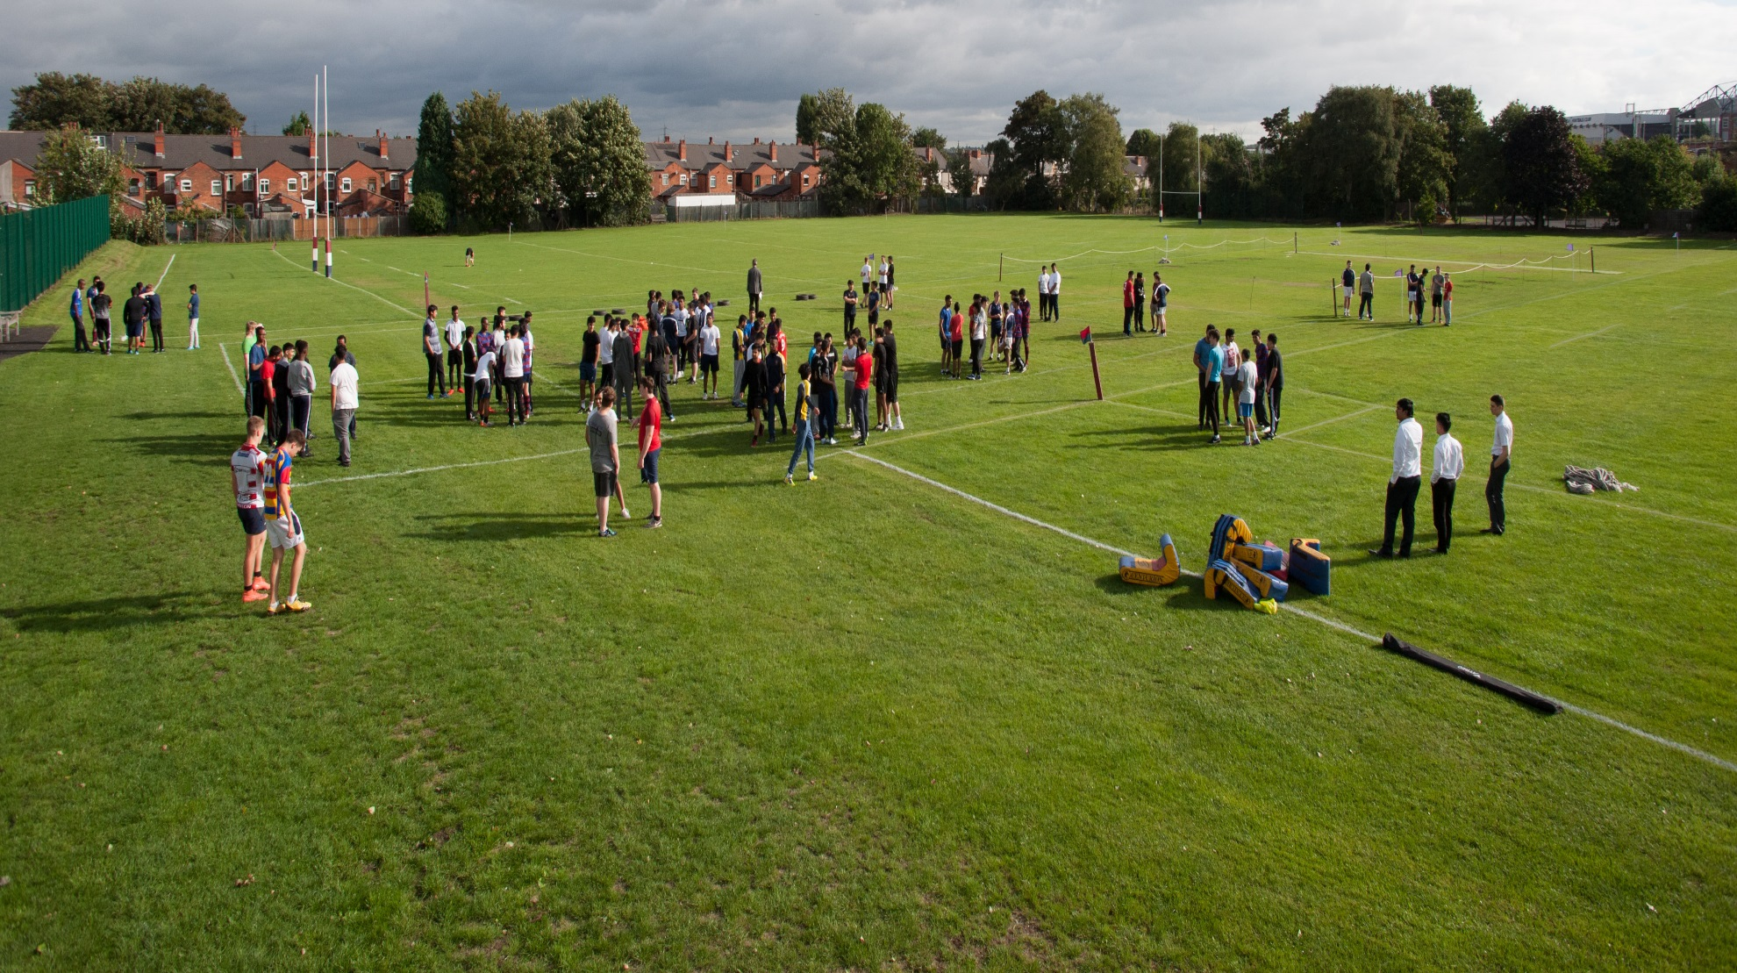
Trinity Road

Slide 9
Curriculum matters
We believe that all students should follow a broad & balanced curriculum which will include plenty of opportunities outside of the classroom.
The curriculum is not the examination syllabus.
Residential in Year 8 offered to all students.
Until the age of 14. This will include the study of Art, Music, Design Technology, Computer Science, History, Geography, French, German or Mandarin & RE as well as Mathematics, English & Science.
At GCSE we require all students to study English Language & Literature, Mathematics, Biology, Chemistry, Physics & RE and three other subjects from Art, Computer Science, Design & Technology, French, Geography, German, History, Mandarin, Music & PE.

Slide 10
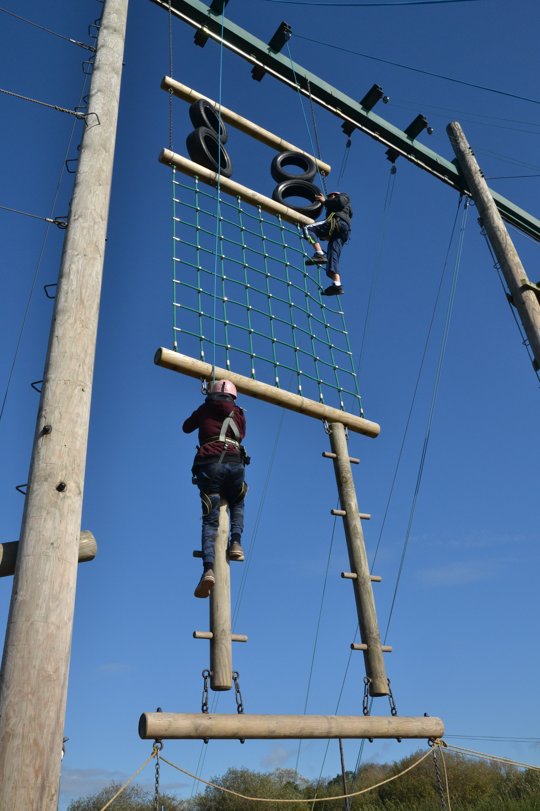
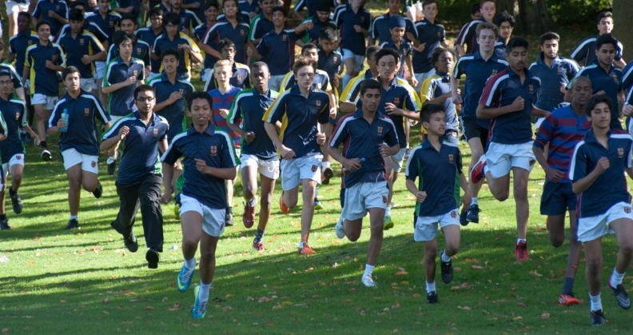
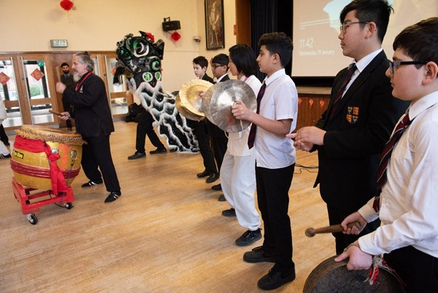
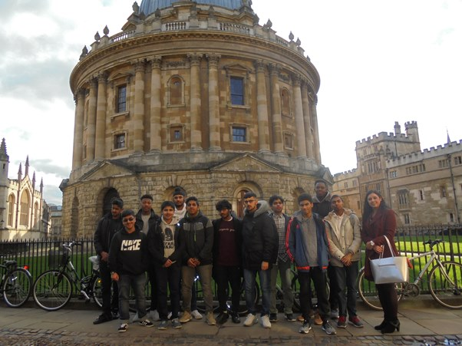
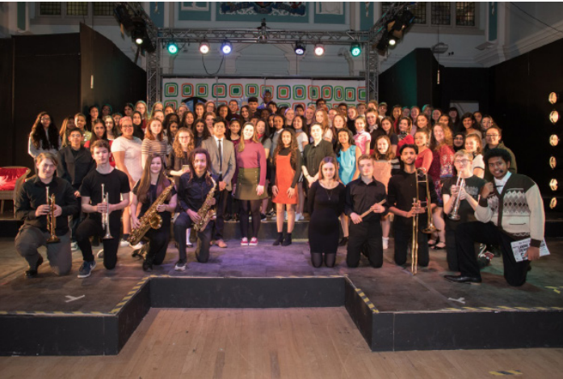
Outside the classroom

Slide 11
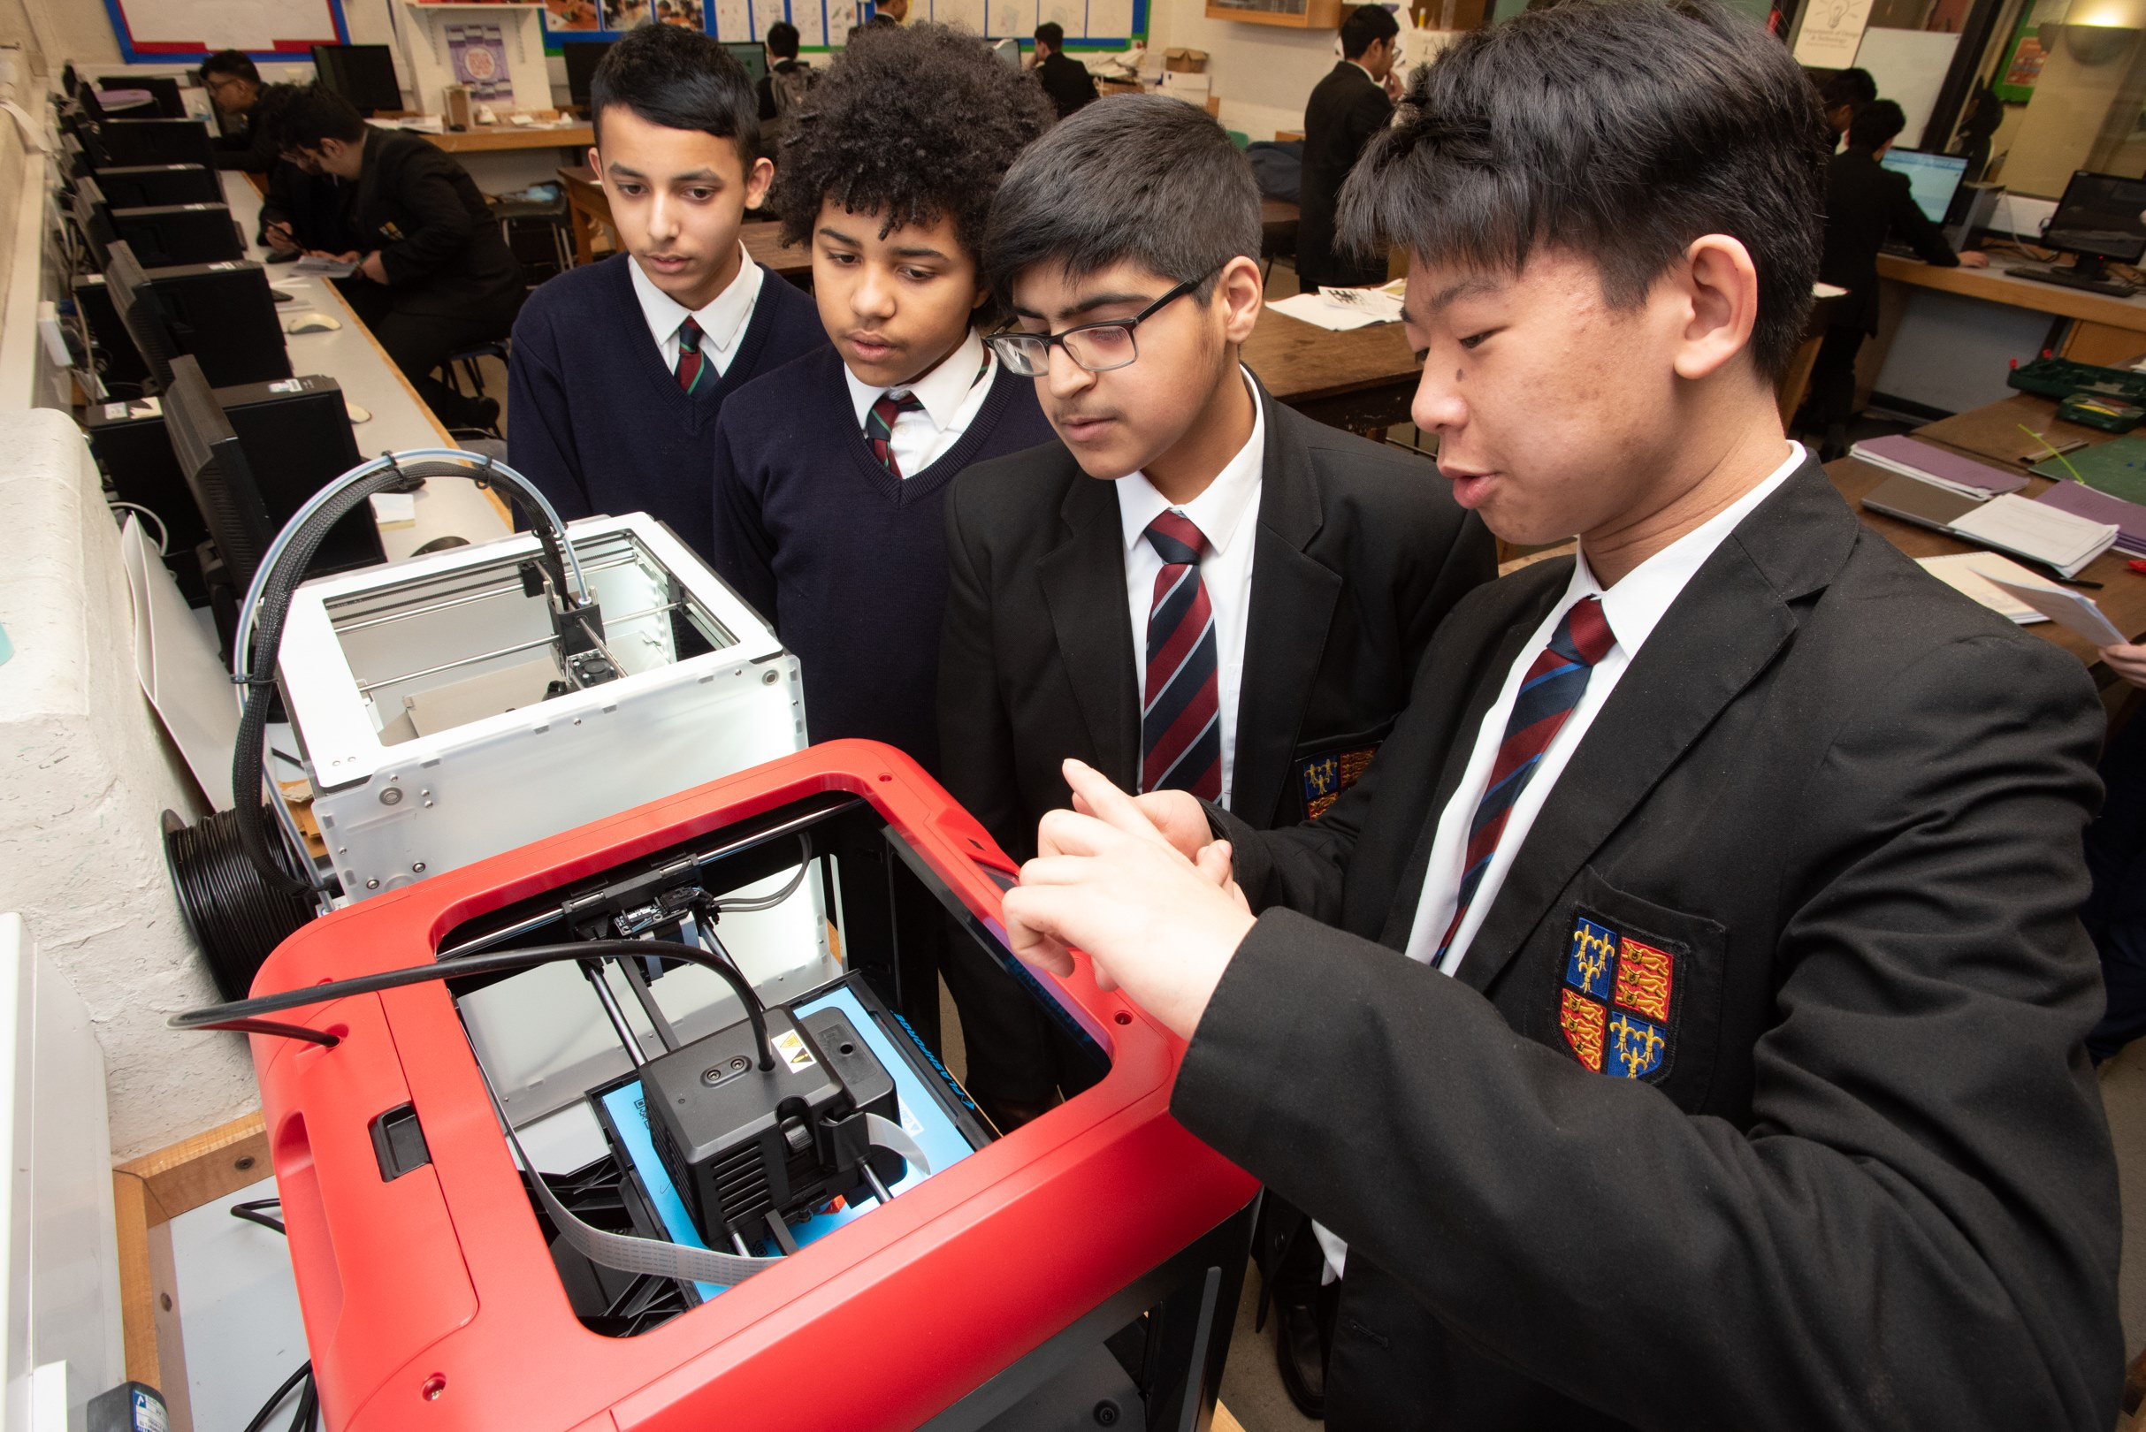
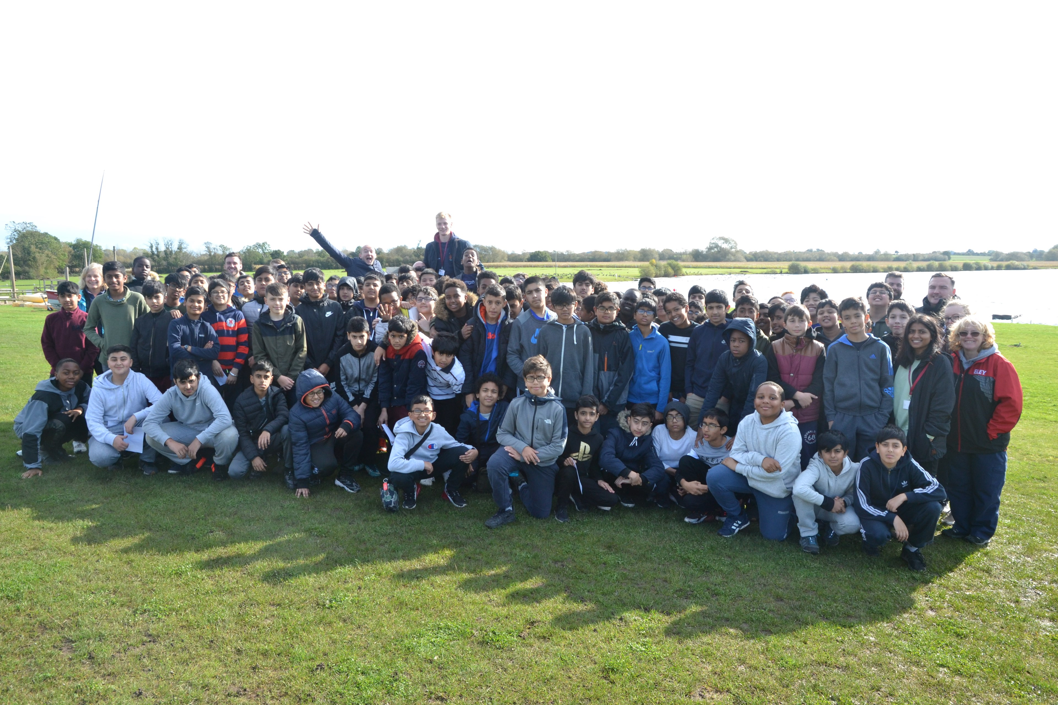
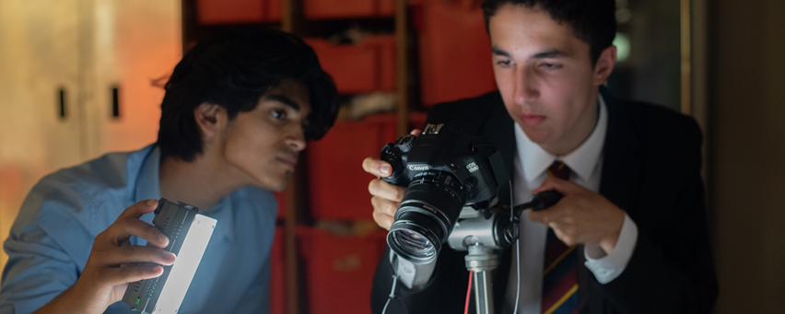
Learning by working together

Slide 12
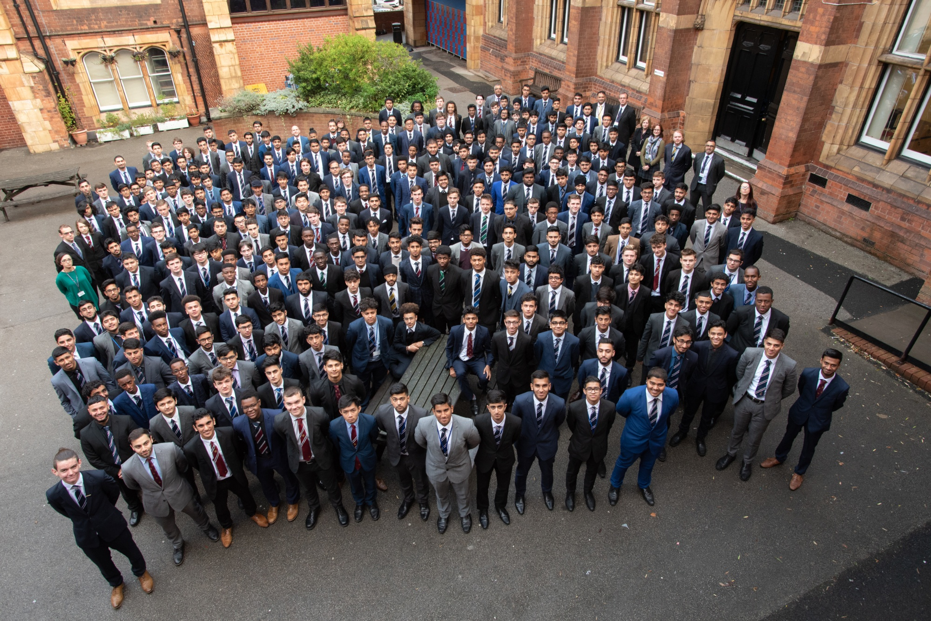
Student Leadership

Slide 13
Being happy at school
Emphasis on student safety
Clear expectations on behaviour
Zero tolerance of bullying in any shape, size or form
A well developed and resourced Learning Support department to meet the individual needs of all students
A forgiving school

Slide 14
Having ambition
Excellent GCSE & A-Level grades.
Extensive experience of participating in opportunities outside the classroom.
Leadership experience.
Teamwork experience
Experience of being part of a community-Form, House, Year Group & School.
High tariff options after Aston-in terms of courses & institutions.
The above apply to all students at Aston

Slide 15
At the end
On leaving the school we expect Aston students to be articulate, well-educated young men who understand the importance of integrity & tolerance, are capable of independent thought and have the confidence to face future challenges.

Slide 16
Finally
King Edward VI Aston is a school for able boys irrespective of where they went to primary school, the background of their parents or their religious beliefs.

