Slide 1
Year 10 Information Evening Welcome!
25th September 2024

Slide 2
Welcome!
Order of events:
Welcome & Introduction – Mr Downing, Deputy Headteacher and DSL
Supporting learning at GCSE – Mr Hall, Assistant Headteacher
Pastoral support – Mrs Simcox, Head of Year 10
Close and 1-2-1 questions

Slide 3
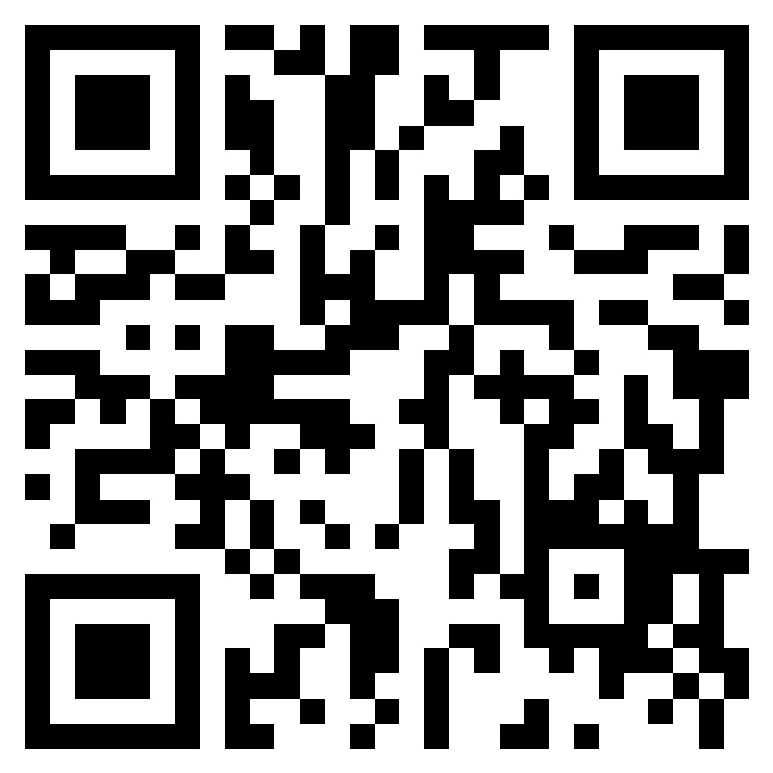
https://forms.office.com/e/H96L2tKe8z
Please complete our online survey
You can also ask any unanswered questions via the feedback form

Slide 4
Supporting your learning at GCSE​ ​ Mr Hall, Assistant Headteacher

Slide 5
Pride in your work
Present your work well
Organise your work
Show your learning and progress

Slide 6
Feedback and improvement
Make sure that you read the comments on your work written by your teachers. Where appropriate make the relevant improvements and changes to your work.
Pay attention to mark schemes.

Slide 7
Grading
Students should be aiming for the best grade possible.
No target grades – aim high!
Always room for improvement.
Achievement and progress over time will be monitored.

Slide 8
Reports
3 per year
Current attainment
Focus on progress over time
Difficult to compare subjects
Yr10 Parents Evening – 13/03/25

Slide 9
Homework
As a guide, we would suggest:
Creating a quiet space where homework can be completed.
Having online access such as a desktop computer, tablet or laptop.
To try and minimise distractions during this time (such as television, phones or computers when not needed for example).
Building time into the week to check homework has been completed.
No homework does not mean do nothing!
Notes:
Challenging – important that everyone is supporting him
Likely that he will need online access
Needs to be completed every evening.
GCSE – amount and nature of HWK increases

Slide 10
Knowing what you know and what you need to know

Slide 11
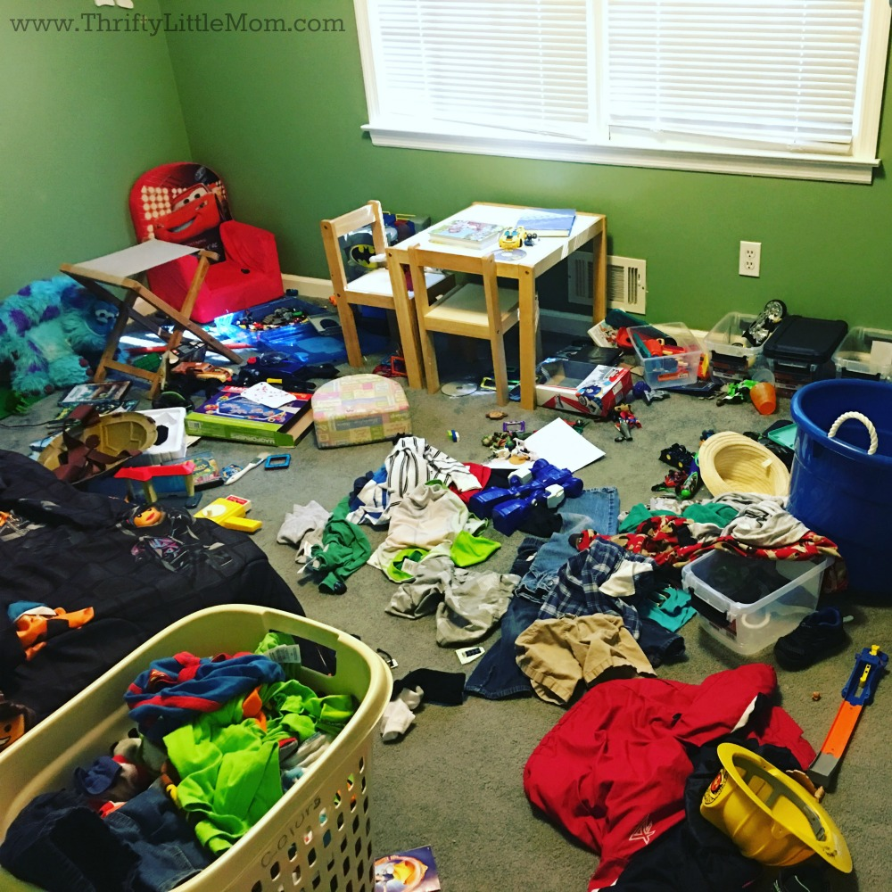
Working habits
Find a quiet tidy space.
This is a pretty straightforward one: you need a place where you can be uninterrupted for a few hours.

Slide 12
Making the learning stick
What works?
“Learners should practise concepts until they have got them right three times, and then study them a further three times at times that are spaced out over days or weeks”

Slide 13
Top Ten Learning and Re-learning Techniques
Practice testing
Distributed practice
Interleaved practice - switching between different kinds of problems
Elaborative interrogation - being able to explain a point or fact
Self-explanation - how a problem was solved
Summarising - writing summaries of texts
Highlighting/underlining
Keyword mnemonics - choosing a word to associate with information
Imagery - forming mental pictures while reading or listening
Re-reading

Slide 14
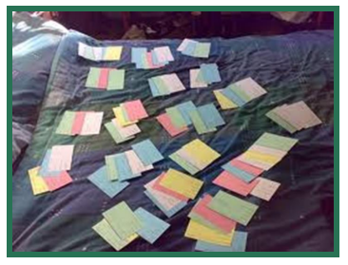
Preparing for ‘Revision’
Reworking the material into a chart or diagram
Summarising material under headings onto index cards

Slide 15
Be active
The most effective ways of remembering your learning are those in which you interact with the material, making it meaningful to yourself.
Use material to answer a question or address a problem you have not previously tackled.
Make links, comparisons and contrasts between different areas of your course.

Slide 16
Exercise
Physical activity is very important, in particular during intense study time. Even going for a walk after a day of revision will make a huge difference to your wellbeing.
Physical activity increases heart rate which makes the blood circulate faster. This in turn ensures that brain gets more oxygen which increases productivity whilst reducing tiredness and stress.

Slide 17
Reward yourself
It is not all about the work; you need good breaks too.
People who manage to find the right balance between study and leisure are the ones who get the top marks.

Slide 18
Think positive
Keep reading
Keep socialising
Keep up your hobbies
Keep exercising
Keep talking

Slide 19
Pastoral support ​ Mrs Simcox, Head​ of Year 10

Slide 20
Pastoral team
Tutors:
10B: Miss Moore j.moore@ast.kevibham.org
10F: Mrs Whyte k.whyte@ast.kevibham.org
10H: Mr Lawson e.Lawson@ast.kevibham.org
10M: Miss Williams c.williams@ast.kevibham.org
10T: Miss Wilkinson j.Wilkinson@ast.kevibham.org
Head of Year: Mrs Simcox m.simcox@ast.kevibham.org
Head of Pastoral Care: Mr. M. Downing m.downing@ast.kevibham.org

Slide 21
Academic support – Heads of Faculty
Mrs. Boyce. - Maths
Mrs. J. Dhillon – Biology
Mr. A Russell – Computer Science
Miss. R. Walsh – Geography
Mrs Cresswell – History
Mr. D Smart – P.E.
Mr. M. Wilcock – R.E.
Mr. C. Laverty – English
Miss. J. Moore – Art
Mr. R. Giubertoni – Chemistry
Mr. M. Hodgkinson – D.T.
Mr. M. Wilcock – R.E.
Mrs. H. Liu – Mandarin
Mr. S. Kumar – Physics
Mrs. N. Wiessmann-Hubbard - Modern Foreign Languages

Slide 22
Learning Support team
Mrs V. Davies: SENCO – V.Davies@keaston.bham.sch.uk
Mrs D. Toland
Mrs R. Rasool-Butt
Mrs H. Mound
Mrs S. Tall
Wellbeing Counsellor
Educational Psychologist
Speech Therapist
Learning Mentors

Slide 23
What can the Learning Support team do?
Dyslexia / Dyspraxia testing and support
Identify pupils in need of additional support
Teach and support pupils on the Learning Support Register
Provide additional assistance in weak subjects
Plan and implement support in lesson
Provide support to students with English as an additional language
Advise teachers and parents on how to support pupils in school and at home
Liaise with external support agencies
Organise a range of support materials
Ensure equal access for all pupils to all school activities
Maintain relevant skills/training/qualifications
Speech Therapy
Behaviour support
Counselling
…… and much more

Slide 24
The Hub
Director of Inclusion Mrs Blundell s.blundell@ast.kevibham.org
Student Support Assistant Mrs Palmer j.palmer@ast.kevibham.org

Slide 25
Our expectations
Give every subject 100% effort
Keep on top of your home-study - for you, not just to keep your teacher happy.
Tell us if you are struggling with anything.
Make sure you have a good place to study and have your planner checked!

Slide 26
Overall
Maintain a healthy work / life balance
Bring up little issues before they become big issues
If you put your all into everything you do, you can do anything.
The school is here to support in this next stage of your school-life.

Slide 27
https://forms.office.com/e/H96L2tKe8z
Please complete our online survey
You can also ask any unanswered questions via the feedback form

